Slide 1
PrOject title: Pandas Analytics-Analysis of 3 Different Branches of Company XYZ across Nigeria.
Olalekan Salako

Slide 2
agenda
Introduction
Analysis Methodology
Result
Conclusion/Summary

Slide 3
- Company XYZ owns a supermarket chain across the country. Each major branch located in 3 cities across the country recorded sales information for 3 months, to help the company understand sales trends and determine its growth, as the rise of supermarkets competition is seen to increase. - The data folder contains datasets from three different branches; Lagos, Abuja and Port Harcourt.
INTRODUCTION:

Slide 4
Analysis QUESTIONS:
-Which city has the highest sum of Cost of Goods Sold(COGS)? - Which city has the highest mean of Cost of Goods Sold(COGS)? - Which city has the highest Gross Income? - Which city has the highest Unit Price? - Which city has the highest quantity of goods? - Which branch has the highest sales record? - Which one is the most used payment method? - Which one is the highest sold product line? - State the payment method/channel used by most customers for each product line - State the highest payment channel/method for each branch - Which is the most available product line in terms of Qty? - List the highest sold product line in each city - Name the branch with highest and lowest ratings - Mention the most purchased product line - Briefly explain the interaction of Unit Price and Quantity of goods purchased

Slide 5
Methodology:
Data Collection
Reading The Datasets
Viewing The Datasets
Data Cleaning and Preparation

Slide 6
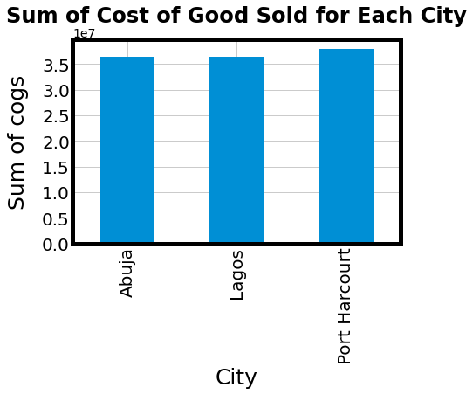
Results:
Port Harcourt is The City with The Highest sum of Cost of Goods Sold(cogs) of 37909270.8

Slide 7
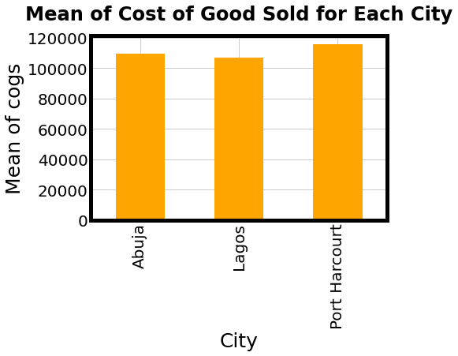
Port Harcourt has The Highest mean of Cost of Goods Sold(cogs) of 115577.045122

Slide 8
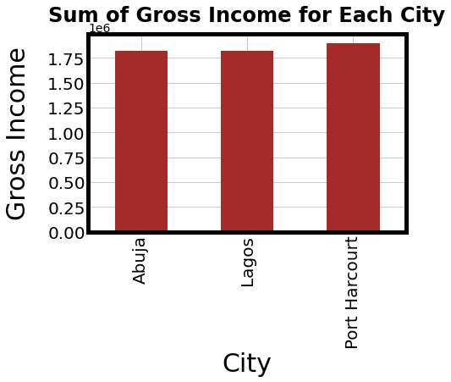
Port Harcourt has The Highest gross income of 1895463.54

Slide 9
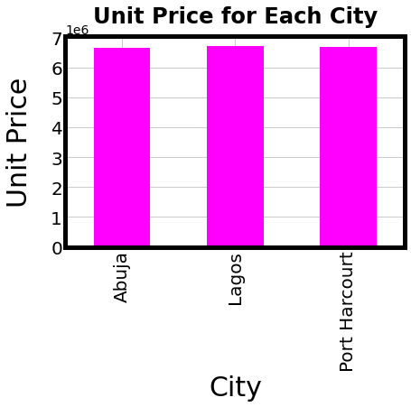
The City with Highest Unit Price is Lagos

Slide 10
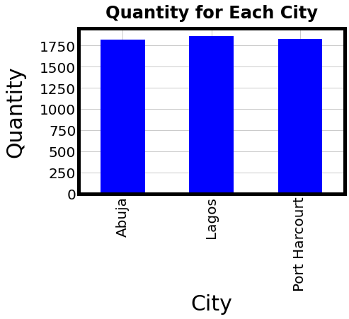
The City with Highest Quantity is Lagos

Slide 11
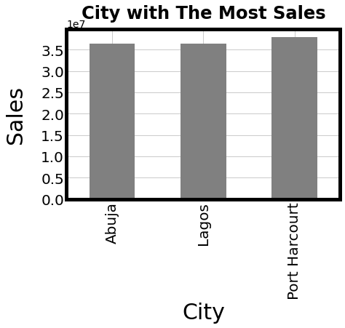
City with The Most Sales is Port Harcourt

Slide 12
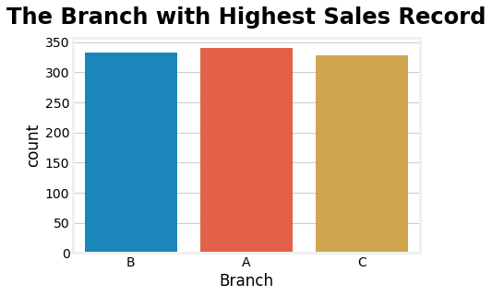
The Branch with The Highest Sales Record is Lagos

Slide 13
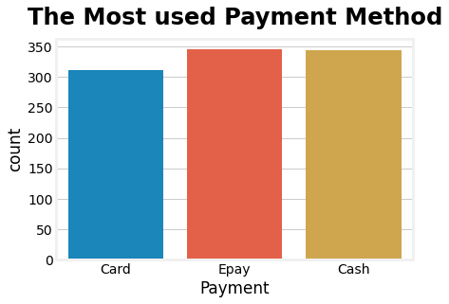
The Most Used Payment Method is Epay

Slide 14
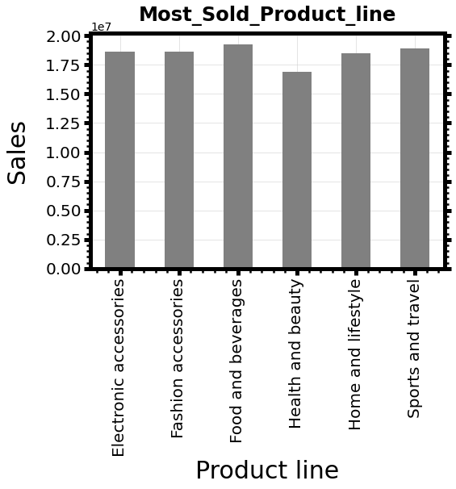
The Highest Sold Product line is Food and Beverages, closely followed by Sports and Travel. While The Least Sold Product line is Heath and Beauty

Slide 15
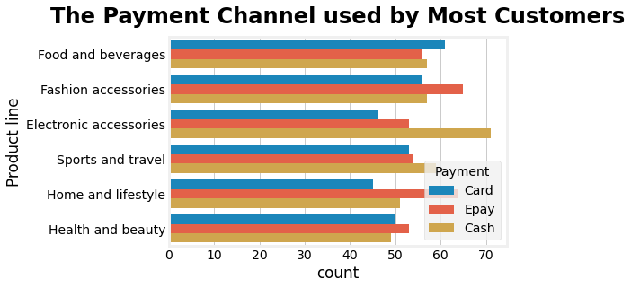
a.. The payment channel used by most customers to pay for Electronic Accessories is cash b.. The payment channel used by most customers to pay for Food and Beverages is card c.. The payment channel used by most customers to pay for Fashion Accessories is Epay d.. The payment channel used by most customers to pay for Sports and Travel is cash e.. The payment channel used by most customers to pay for Home and Lifestyle is Epay f.. The payment channel used by most customers to pay for Health and Beauty is Epay

Slide 16
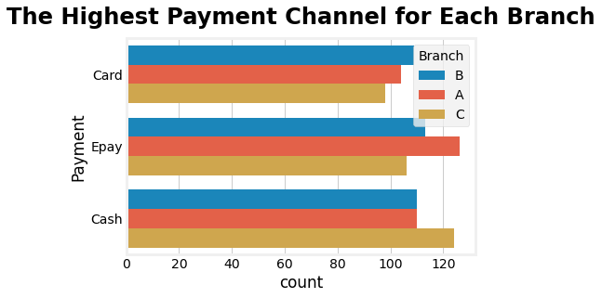
a.. The highest payment channel for Abuja_Branch is Card. b.. The highest payment channel for Lagos_Branch is Epay. c.. The highest payment channel for Port_Harcourt_Branch is Cash

Slide 17
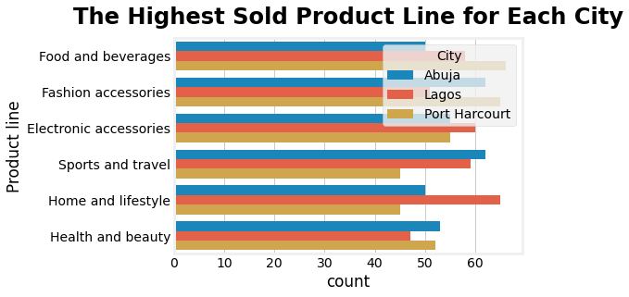
a...Lagos had the highest sales of Electronic Accessories b...Port Harcourt had the highest sales of Fashion Accessories c...Port Harcourt had the highest sales of Food and beverages d...Abuja had the highest sales of Sports and travel e...Lagos had the highest sales of Home and lifestyle f...Abuja had the highest sales of Health and beauty

Slide 18
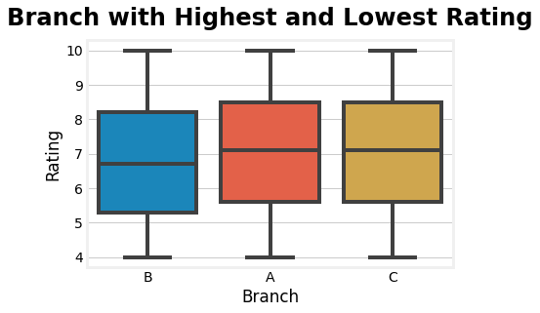
a...The Branch with Lowest Rating is Abuja b...The Branch with Highest Rating is Lagos

Slide 19
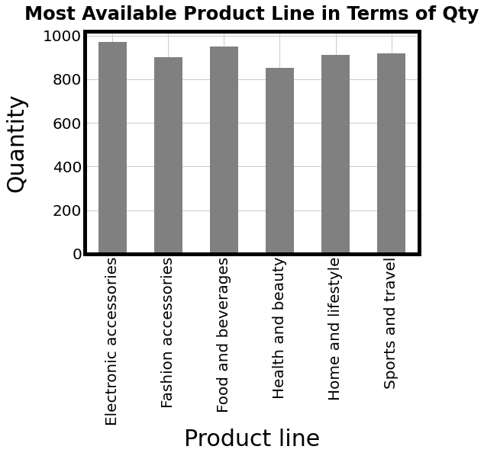
The Most Purchased Product line in Terms of Qty is Electronic Accessories

Slide 20
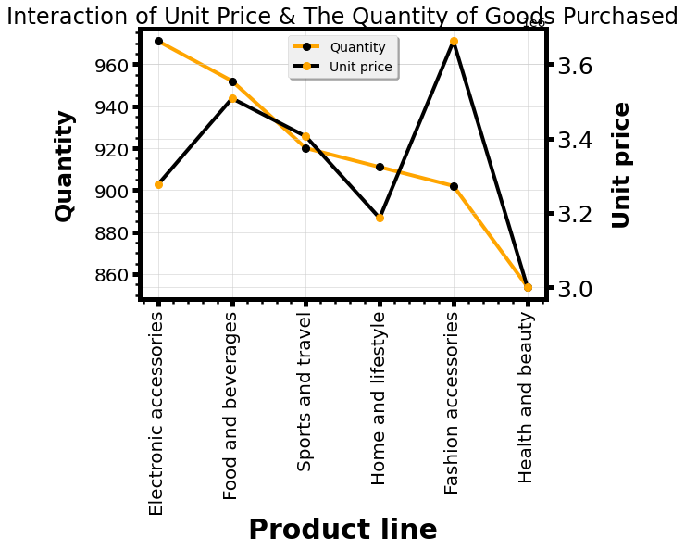
- Based on the analysis, electronic accessories were the most sold Product line with a bit higher prices. - Fashion accessories were so expensive and very little quantities were purchased.
Health and Beauty were the least sold Product line despite lower prices.

Slide 21
Conclusion/Summary:
- More products should be given to Port-Harcourt branch. And advertisement on all the products should not stop. - There is a lot more to do on Abuja branch. New marketing strategies should be carried out to boost sales. - Health and Beauty product line should be given much more priority in terms of good marketing strategies and promotions on regular basis.
Moreso, if the prices of Food and Beverages were reduced a little bit, I believe there will be much more sales in them than other products.

